Slide 1
CIS 55 – iOS Programming
Manish Goel

Slide 2
Lecture Agenda
Textbook update
Tutoring help
iOS developer accounts
Why Swift?
Introduction to the Swift language
Data Types
Conditionals / Decisions
Loops / Control Flow
Arrays / Collections

Slide 3
Review
Our first “Hello World” app
AppDelegates, View Controllers
Understanding the Xcode IDE
Resources

Slide 4
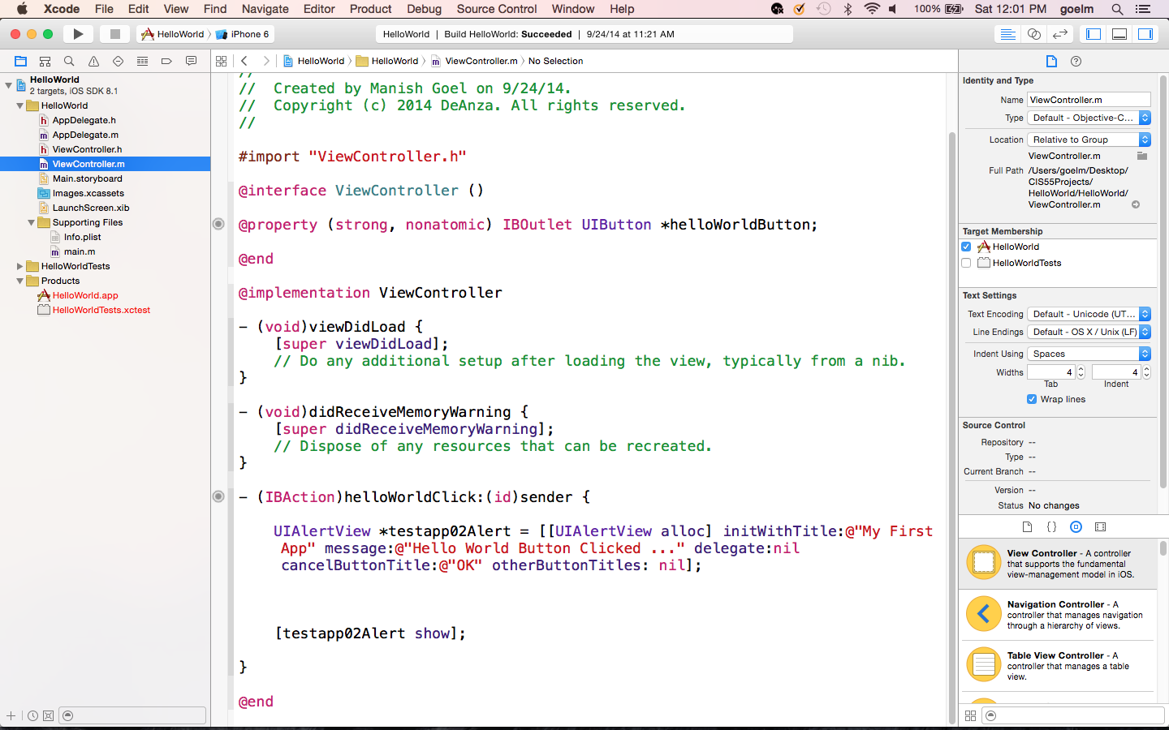
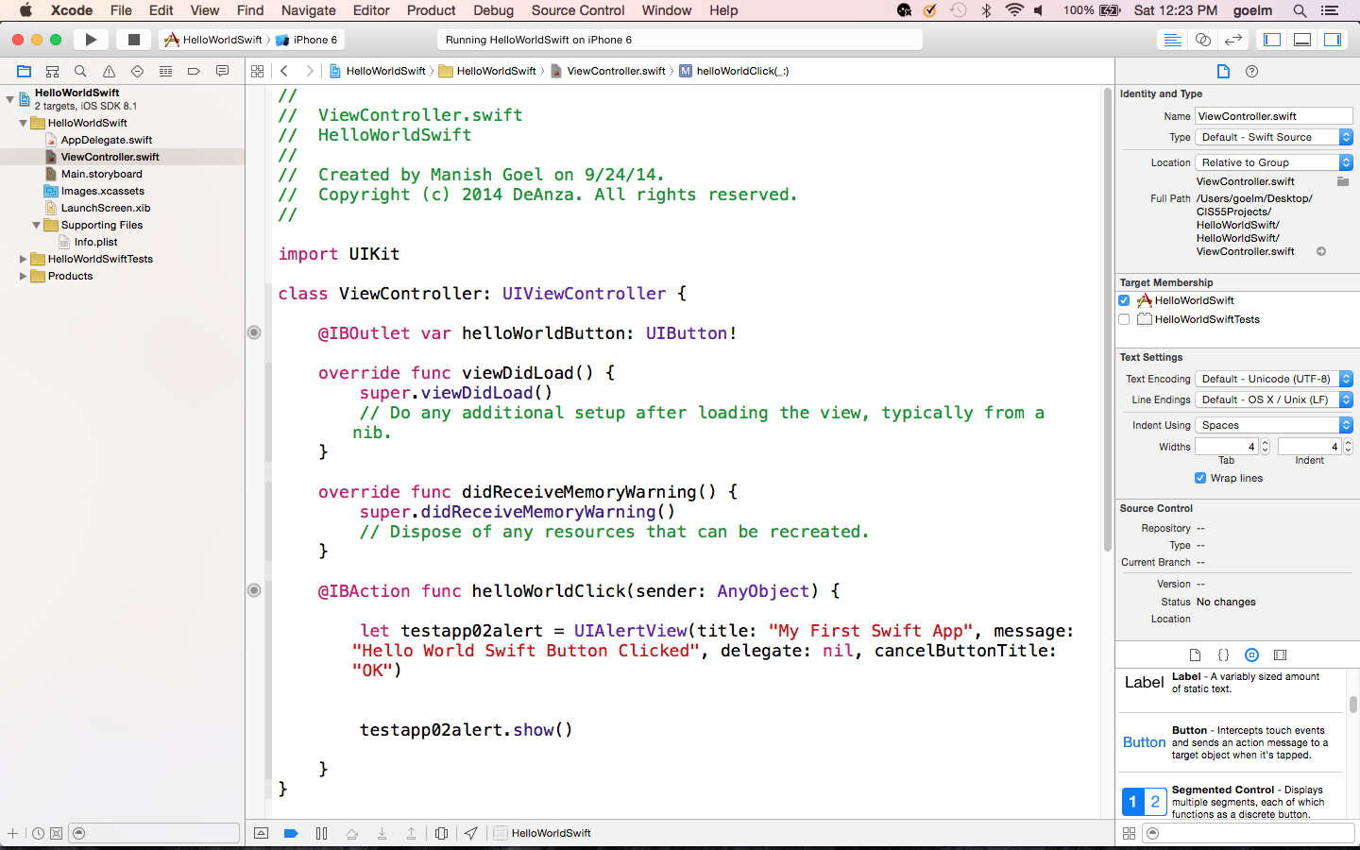
Objective-C vs Swift – Hello World
It is the same code but much simpler to understand in Swift –
no more pointers, allocators, @ for strings, semi-colons

Slide 5
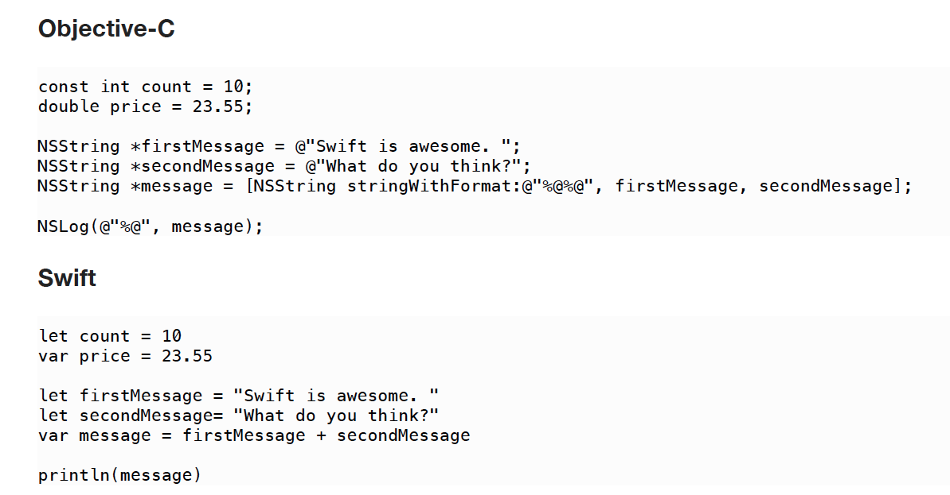
Objective-C vs Swift – Joining Phrases
How about now?

Slide 6
Basic Swift Constructs
Data Types – define what type of data in use
Numbers (Int, Double) , Text (String) , Multi-Value (Tuples)
Other data types – introduced when used later in clas
Decision Making Code – decide which code to execute
If , If-else , If-else if , switch
Loops – repeating same code many times as needed
while , do-while , for
Various ways of handling ranges
Arrays – collections of similar type of data

Slide 7
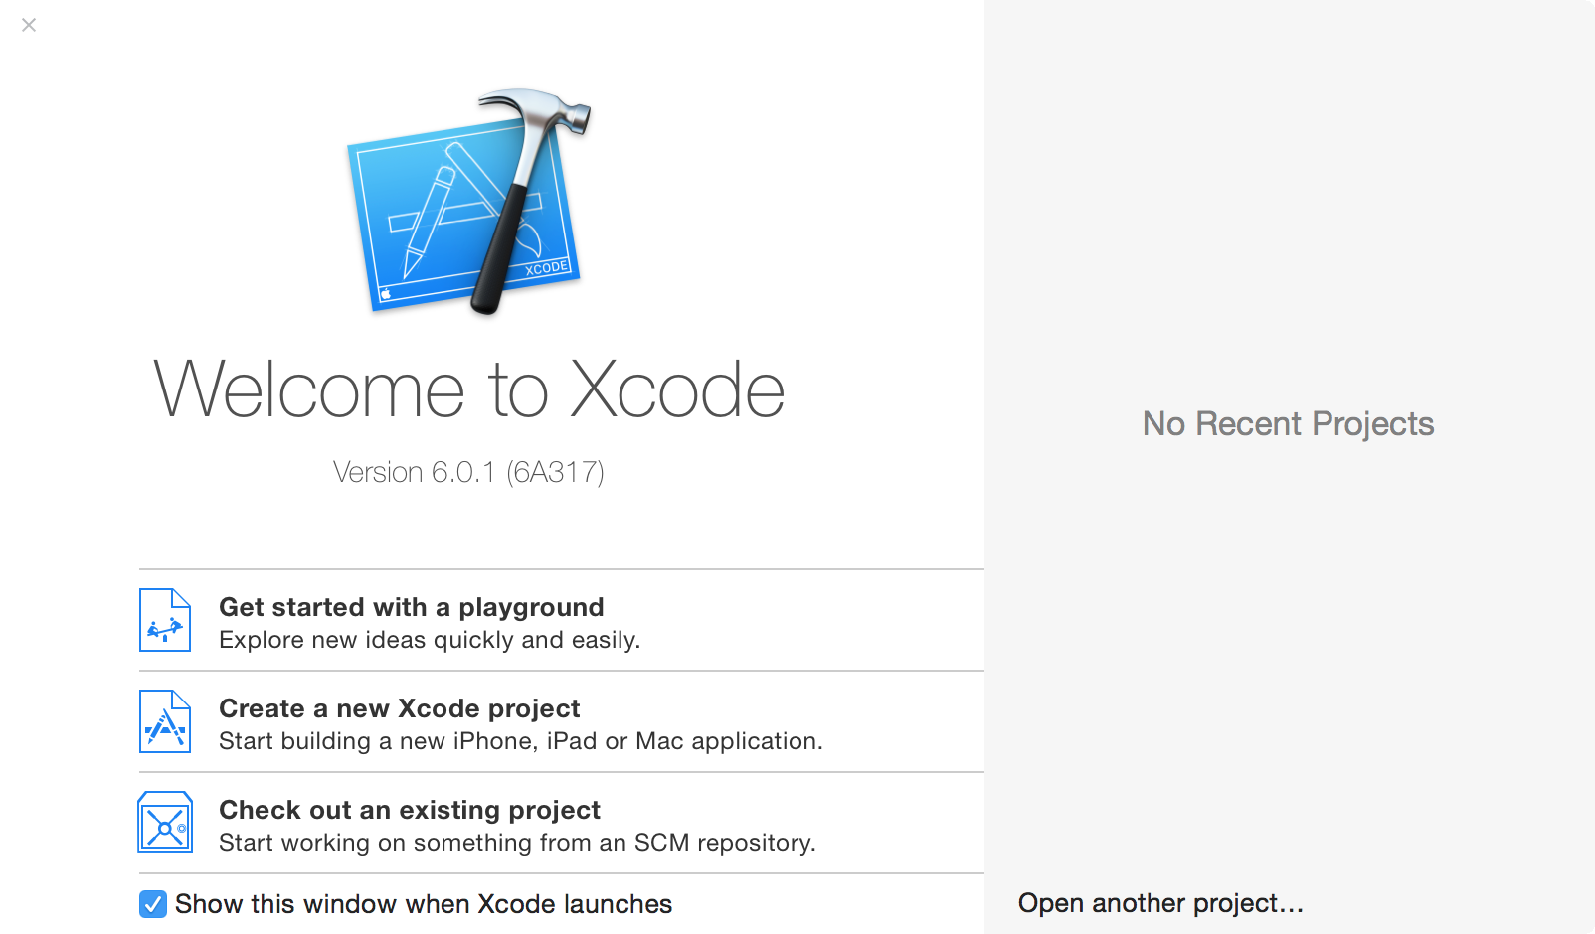
Swift Playgrounds – code sandbox

Slide 8
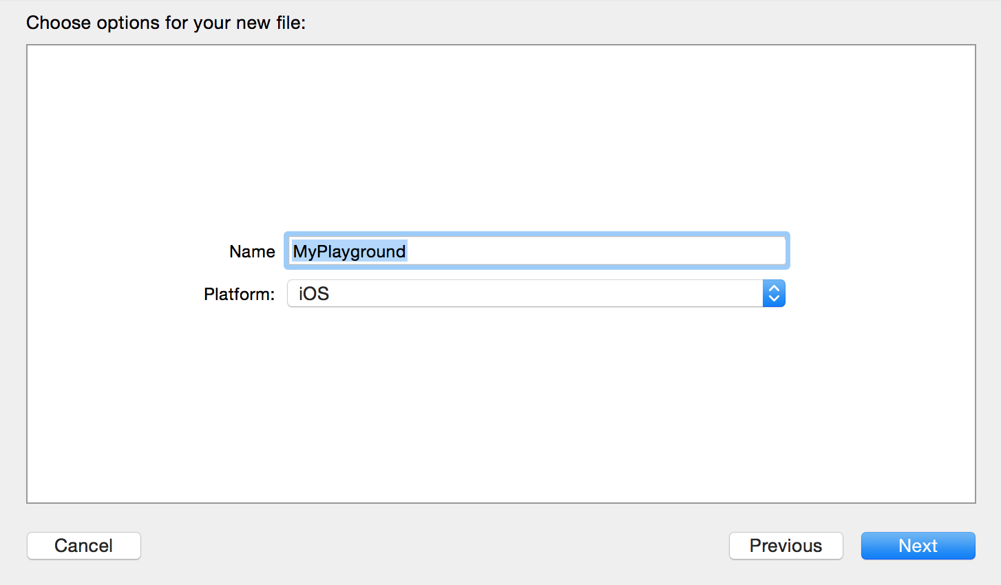
Swift Playgrounds – 2

Slide 9
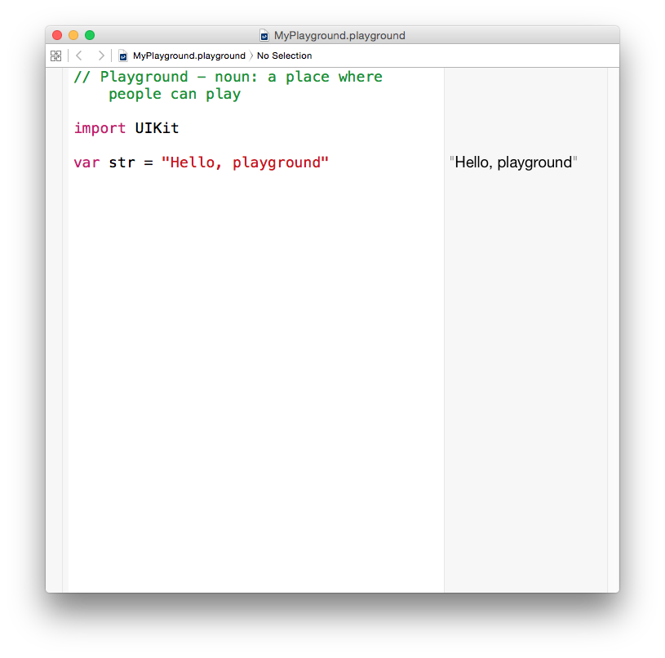
Swift Playgrounds – 3
This is the default playground file

Slide 10
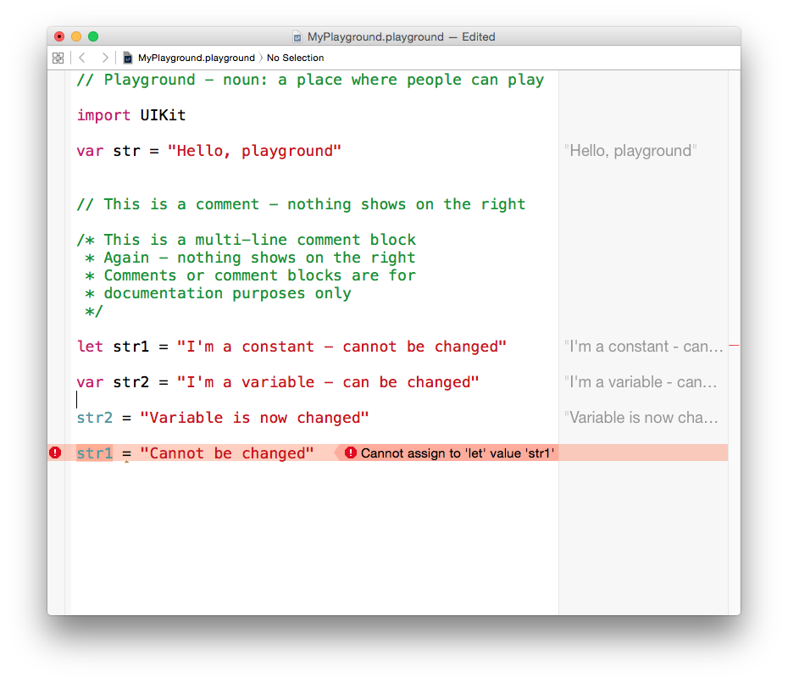
Swift Playgrounds – 4

Slide 11
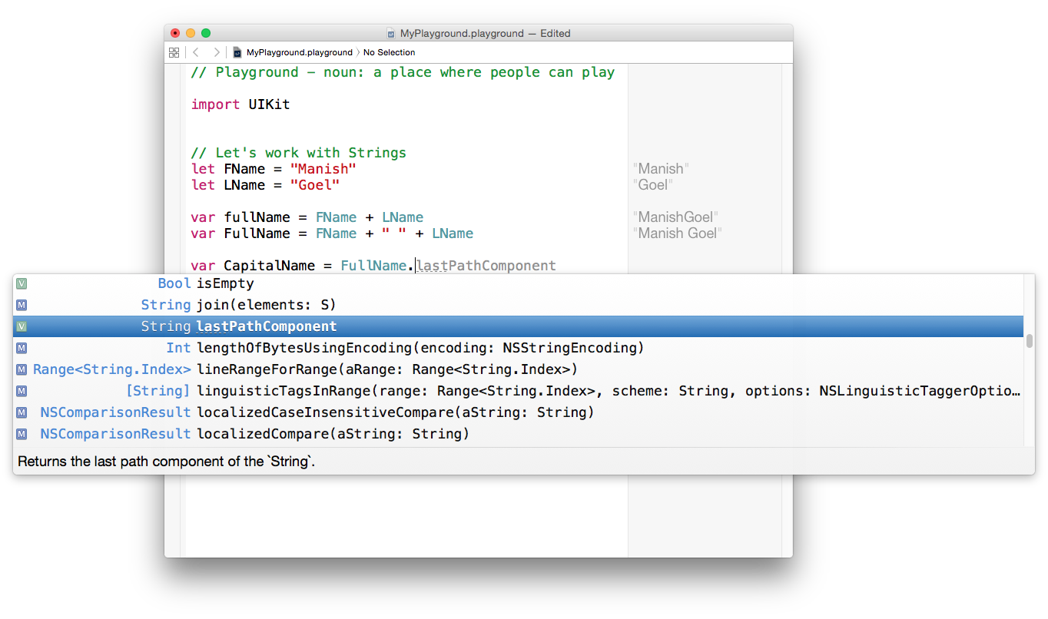

Slide 12
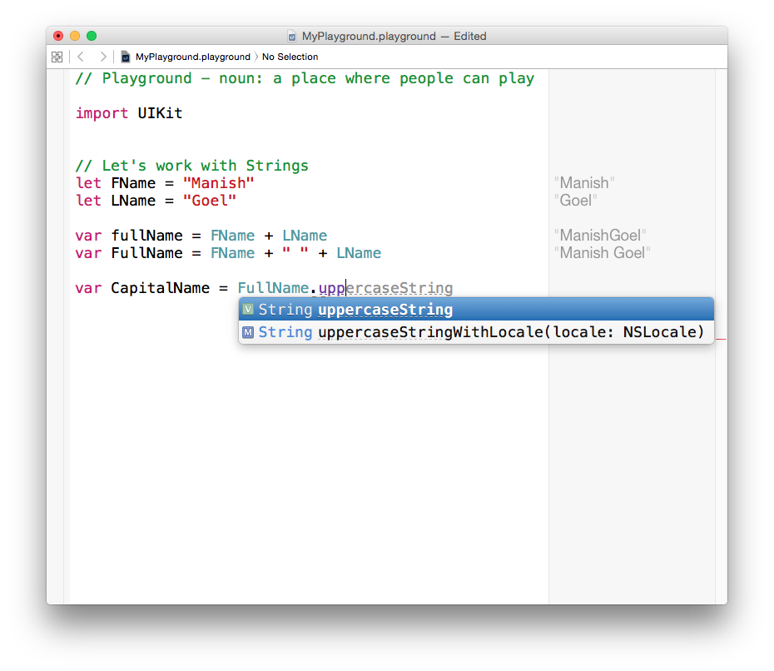
The Xcode IDE is designed to provide contextual help – don’t be shy to use it

Slide 13
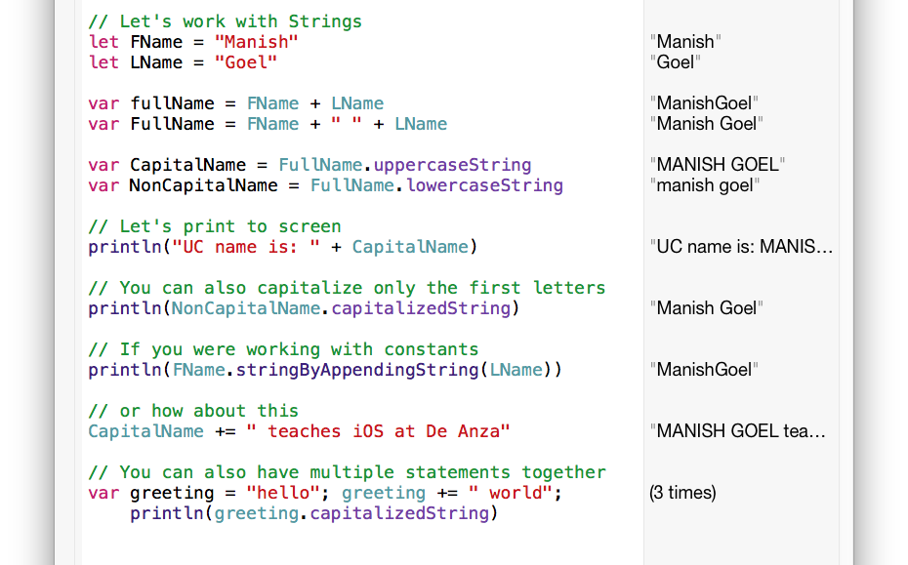

Slide 14
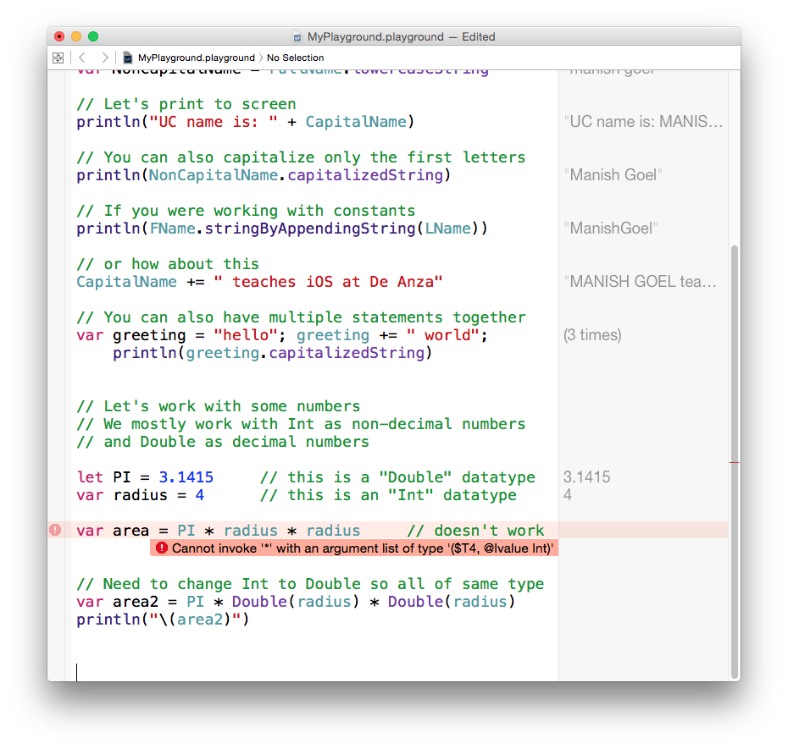
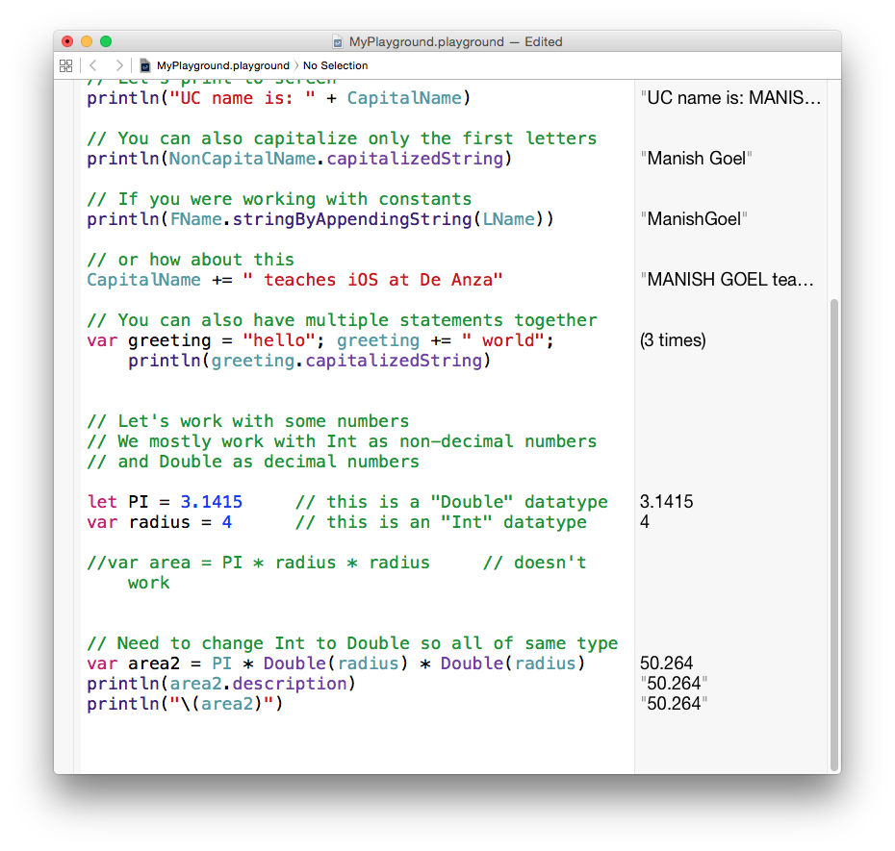

Slide 15
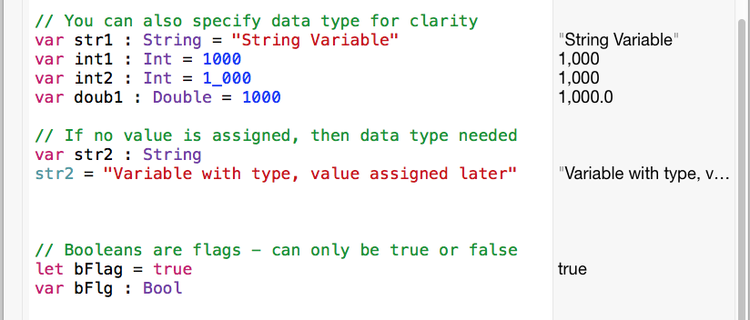

Slide 16
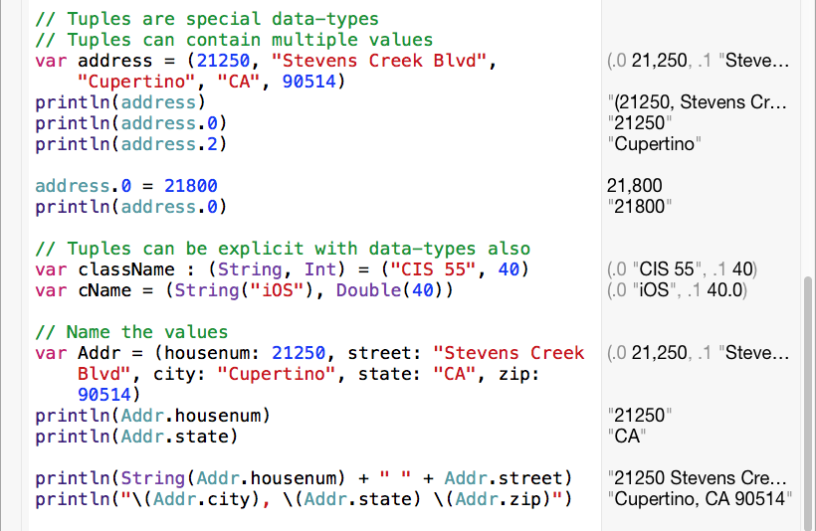

Slide 17
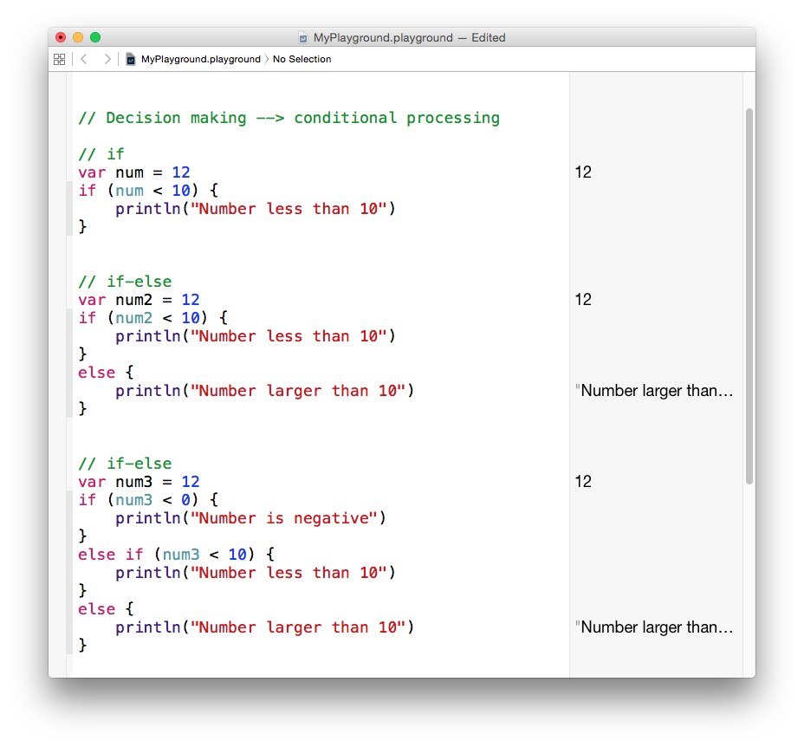

Slide 18
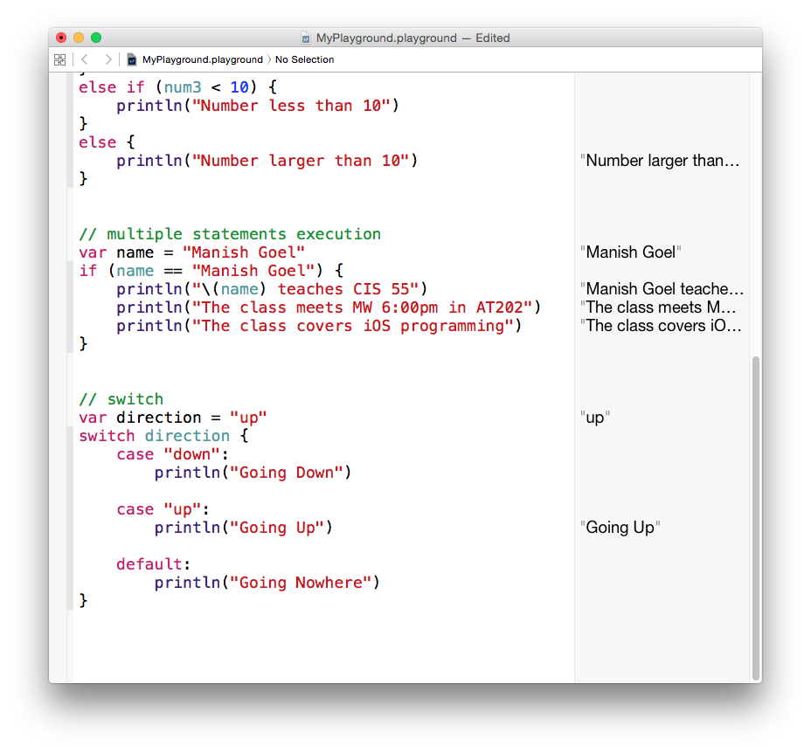

Slide 20
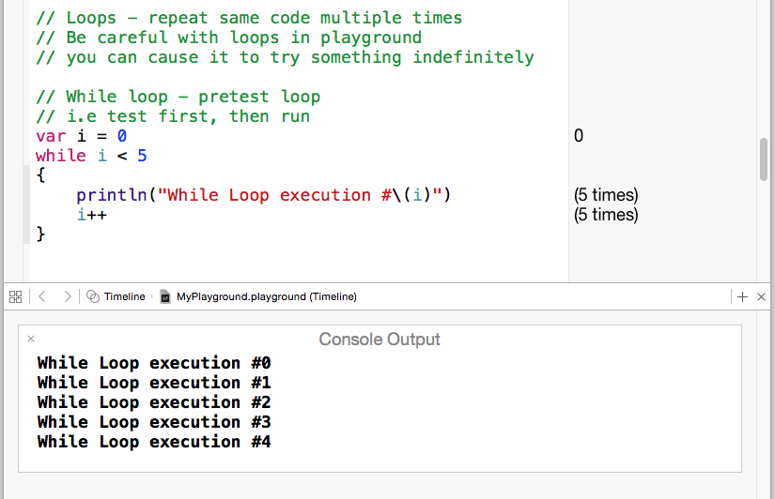
Playground is not very helpful when dealing with many cases especially loops.
To see what the code would do in console, view the assistant editor window from the menu or toolbar.

Slide 21
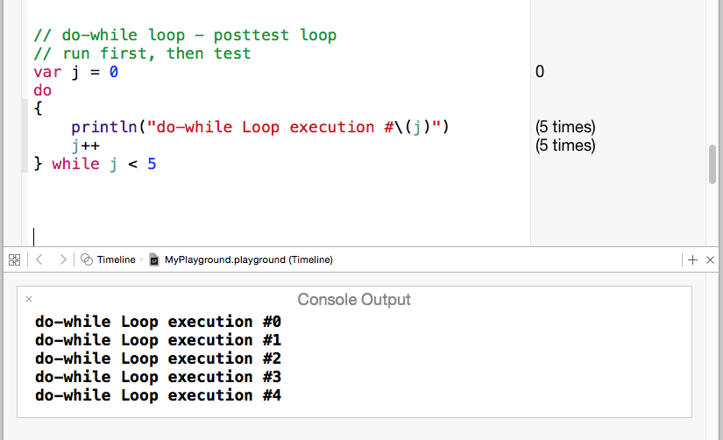

Slide 22
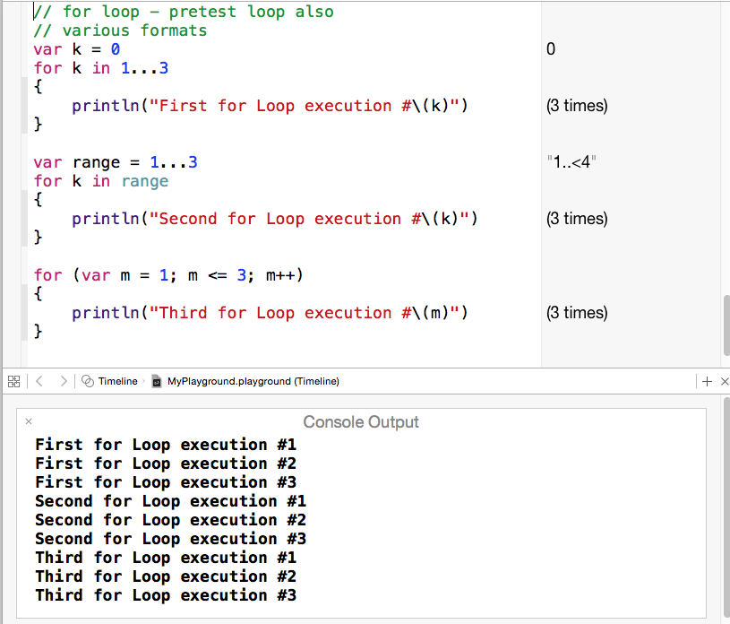

Slide 23
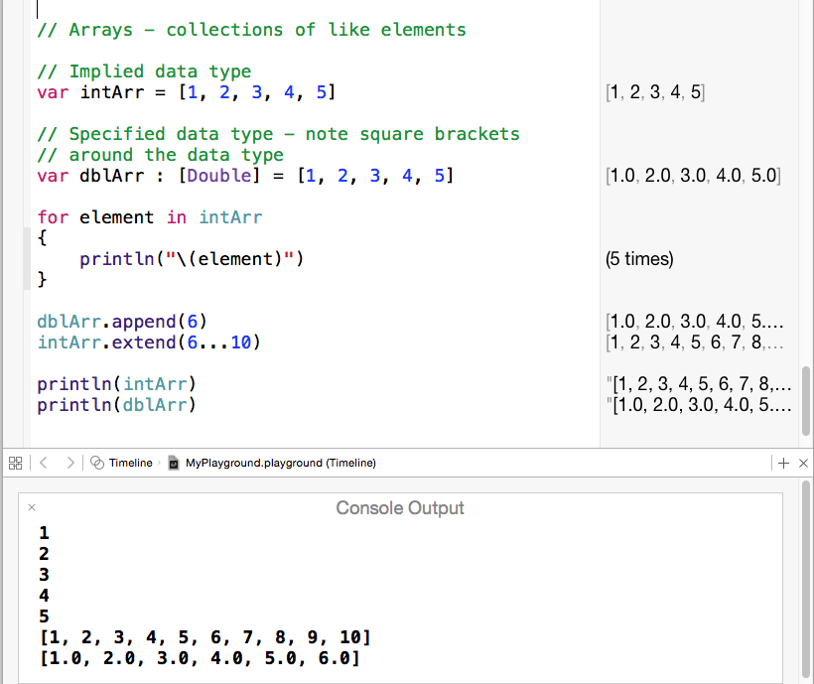

Slide 24
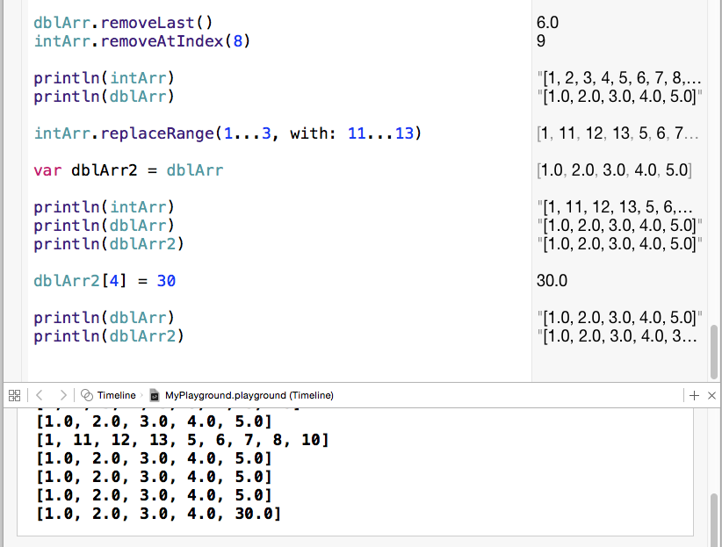

Slide 25
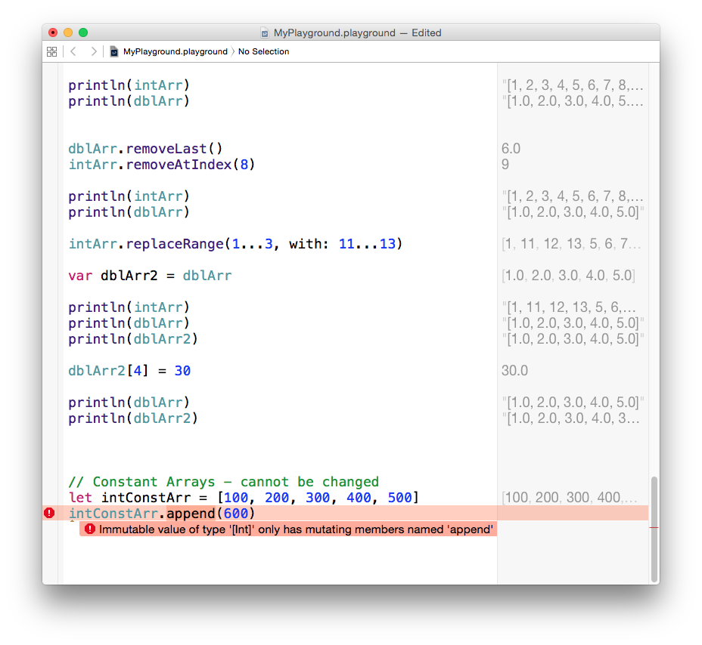
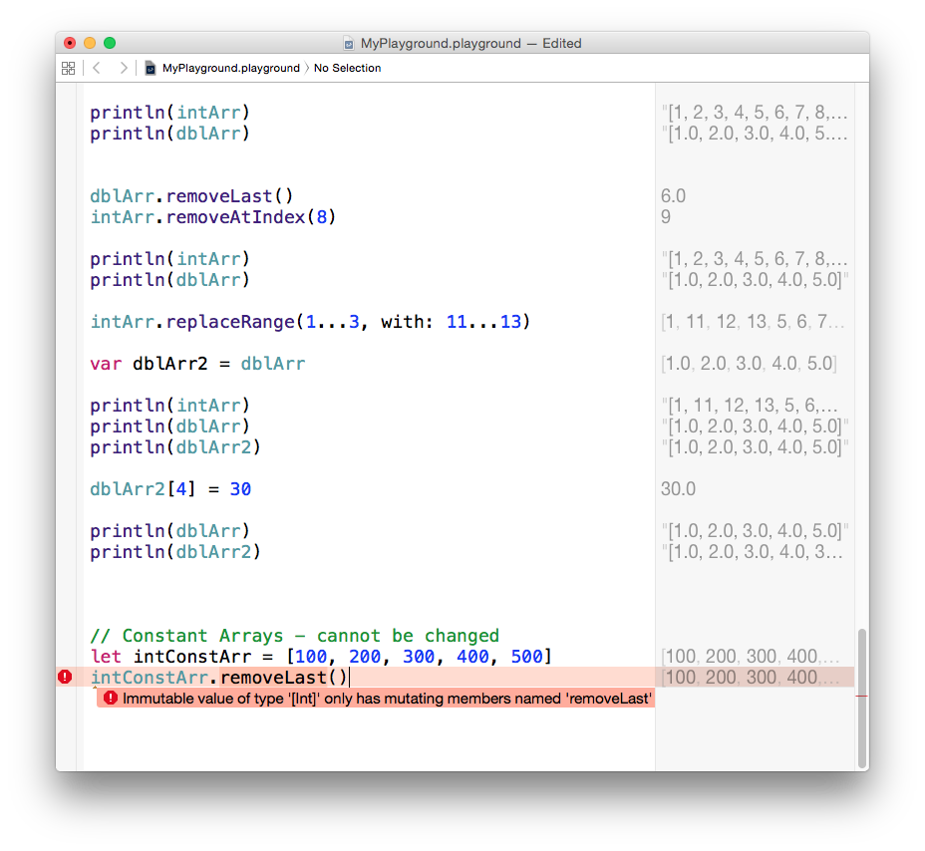
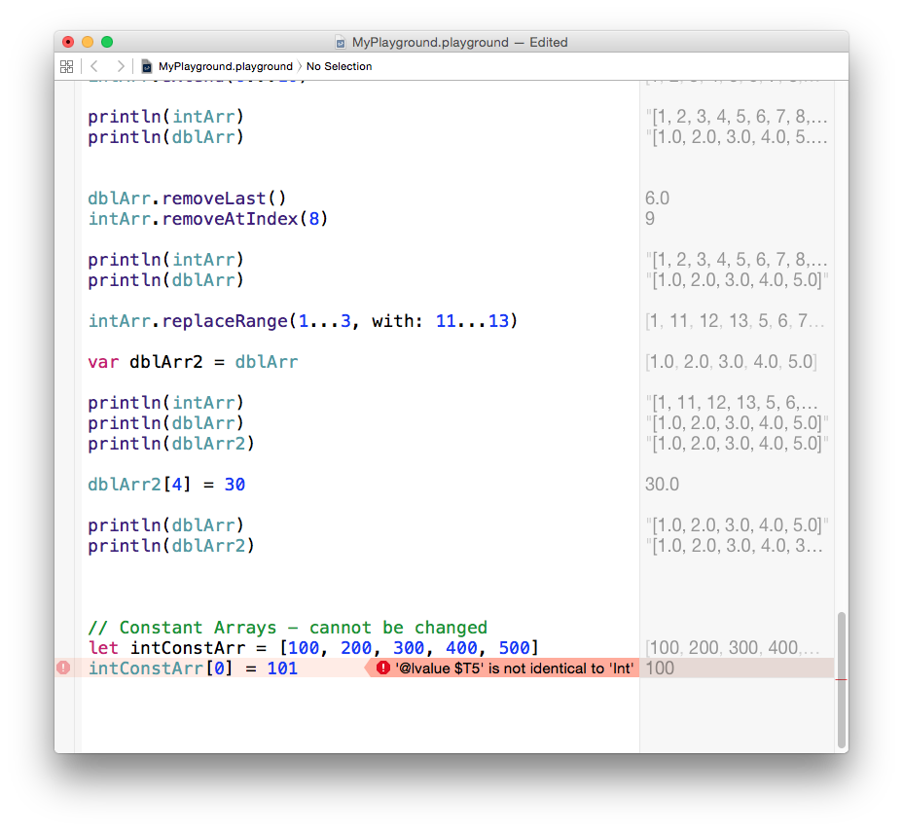

Slide 26
Programming Syntax – Data Types
Data Type | Objective-C | Swift
Integer Types | int / short / long / long long | Int / Int16 / Int32 / Int64
Decimal Type | float / double / long double | Float / Double / <NA>
Boolean | BOOL | Bool
Character | char / unichar | Character
String | NSString * | String
Enumerators | enum <name> {item1, item2 …} | enum <name> {case item1, item2, …}
Array, fixed, 1-D | NSArray *
Array, dynamic, 1-D | NSMutableArray * | Array<type>
Array, dynamic, 2-D |  | Array<Array<type>>
Tuple |  | (name1:val1, name2:val2, name3:val3, …)

Slide 27
Programming Syntax – Declarations
Declarations | Objective-C | Swift
Primitive Constants (numbers, characters, booleans) | const int MY_INT_CONST = 100; | let my_int_const = 100 or let my_int_const : Int = 100
Primitive Variables (numbers, characters, booleans) | int my_int; my_int = 5; or int my_int = 5; | var my_int = 5 or var my_int : Int = 5
Strings | NSString *my_str = @”iOS”; | let my_str = “iOS” // immutable var my_str = “iOS” // mutable
Arrays | NSArray *my_arr = [NSArray arrayWithObjects: @”o1”, “o2”]; NSMutable *my_arr_2 = [NSMutableArray arrayWithObjects: @”OX”, @”OY”]; | let my_arr = [“o1”, “o2] var my_arr_2 = [“OX”, “OY”]

Slide 28
Programming Syntax – Conditional Processing
Conditional Construct | Objective-C | Swift
if … else | if (condition) {instructions} «else {instructions}» // else is optional | Same as in Objective-C (no semi-colons after statements)
if … else if … else | if (condition) {instructions} else if (condition) {instructions} ... «else {instructions}» | Same as in Objective-C (no semi-colons after statements)
switch | switch (variable) { case case1: instructions «break;» ... «default: instructions» } | switch variable { case case1: instructions ... «default: instructions» } // no break

Slide 29
Programming Syntax – Loops
Looping Constructs | Objective-C | Swift
while loops | while (condition) { instructions } | Same as in Objective-C
do-while loops | do { instructions } while (condition) | Same as in Objective-C
for loops | for («type» i = first; i <= last; ++i) { instructions } | for i = first ... last { instructions } or for i = first ..< last+1 { instructions } or for var i = first; i <= last; i++ { instructions }
foreach loops | for (type item in set) { instructions } | for item in set { instructions }

Slide 30
Programming Syntax – Functions
Function Action | Objective-C | Swift
Basic/Void Function | void foo(«parameters») { instructions } | func foo(«parameters») { instructions }
Value Returning Function | type foo(«parameters») { instructions ... return value; } | func foo(«parameters») -> type { instructions ... return value }
Calling a Function | foo(«parameters») | Same as in Objective-C
Required main function | «global declarations» int main(«int argc, char *argv[]») { instructions } | N/A

Slide 31
Programming Syntax – I/O
I/O Type | Objective-C | Swift
stdin (keyboard) | data = [[NSFileHandle fileHandleWithStandardInput] readDataToEndOfFile]; | NSFileHandle.fileHandleWithStandardInput()
stdout (screen) | NSLog(data); or [[NSFileHandle fileHandleWithStandardOutput] writeData:data]; | println(x) or NSFileHandle.fileHandleWithStandardOutput()
stderr (screen) | [[NSFileHandle fileHandleWithStandardError] writeData:data]; NSAssert(condition, description); | NSFileHandle.fileHandleWithStandardError()

Slide 32
Programming Syntax – Exceptions
Exception Set | Objective-C | Swift
throw | @throw exception; | N/A
try … catch | @try { instructions } @catch (exception) { instructions } ... «@finally { instructions }» | N/A
assert | NSAssert(condition, description); | assert(condition«, description»)

Slide 33
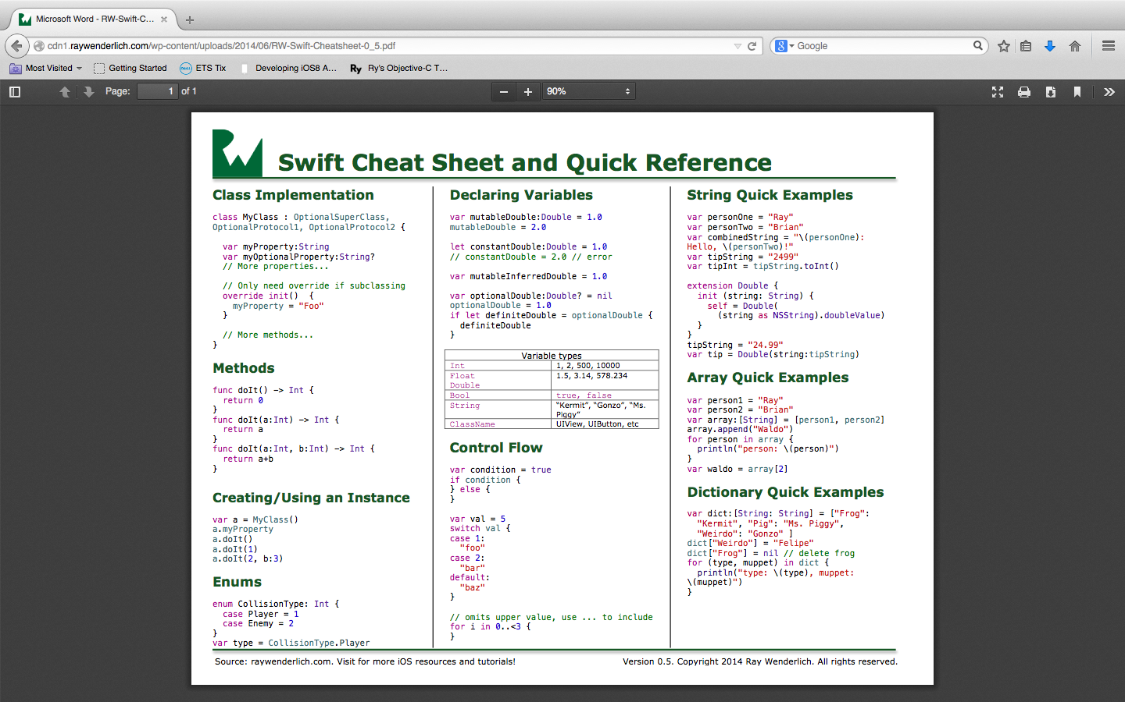
Swift quick facts

